Slide 1

To the Session on Finance…

Slide 2
And, the challenge is to understand the intricacies of Finance…
This session will take you to World of Finance…

Slide 3
So, let’s start our journey…
And, first of all let’s take a look at a Balance Sheet…

Slide 4
READ & THINK!!!

Slide 5
Have you ever wondered what decisions of a firm determine the structure of a balance sheet?

Slide 6
Revisit the Balance Sheet !!!

Slide 7
Main financial decisions impacting the Balance Sheet of a company …
Investment Decisions: Long-term Decisions
Financing Decisions: Capital Structure Decisions
Dividend Decisions: Profit Distribution Decisions
Liquidity Decisions: Working Capital or Short-term Decisions
Who is after these decisions?
It is the CFO of a company who is ultimately responsible for these decisions.

Slide 8
What is the driving OBJECTIVE of the firm behind these financial decisions?
Investment Decisions: Long-term Decisions
Financing Decisions: Capital Structure Decisions
Dividend Decisions: Profit Distribution Decisions
Liquidity Decisions: Working Capital or Short-term Decisions
Is it Profit-Maximization?

Slide 9


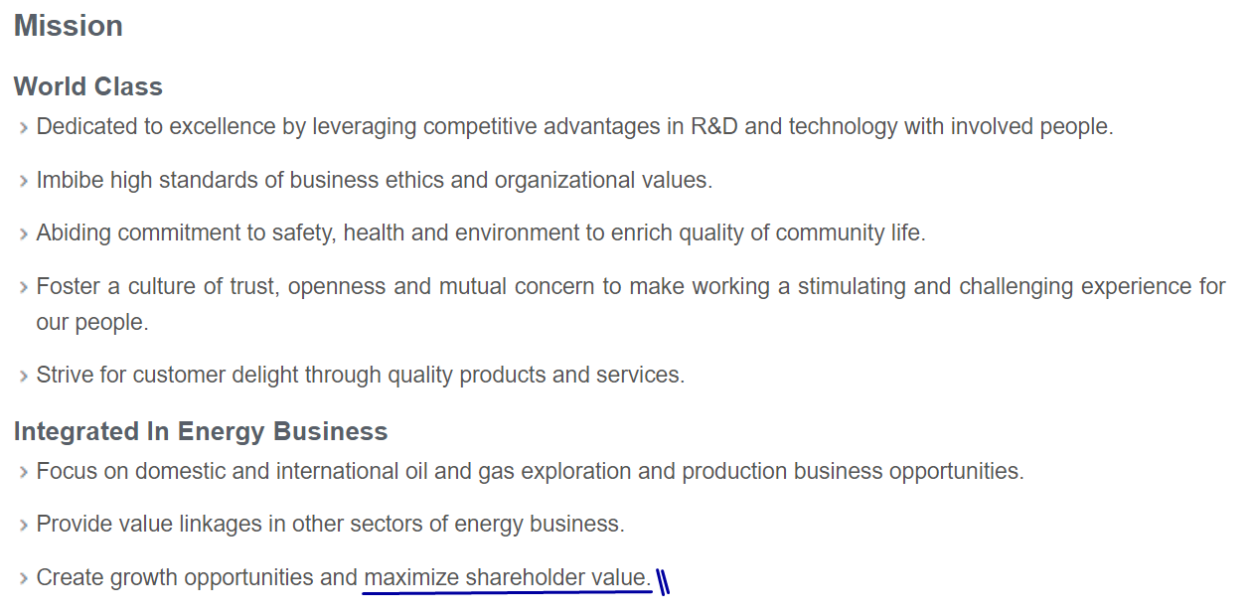
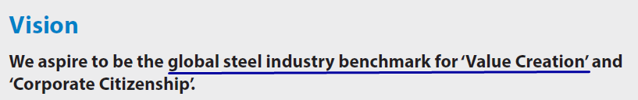
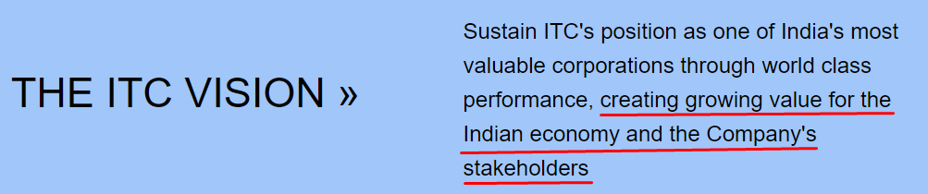
To appreciate the driving OBJECTIVE behind various financial decisions, let’s have a look at some of the Vision/Mission statements of different companies
ONGC
Tata Steel

Slide 10

All these are talking about VALUE and not about PROFIT.
It takes us to an important issue – Profit Maximization Vs. Value Maximization.

Slide 11
PROFIT MAXIMIZATION
Vs. VALUE MAXIMIZATION
Why Profit Maximization?
It is a well understood objective.
It achieves sustainability for a firm as without profits, none can sustain itself for long.
Profit is also considered as a yardstick of efficiency.
In a free and competitive market, profit is the best driving and motivating force behind all economic decisions.
The theory of ‘Invisible Hand’ that ensures optimum allocation of resources for a society in a free and competitive market also depends upon the objective of Profit Maximization.
It is an objective that is compatible with society’s objective as well as firm’s objective.
Why Value Maximization?
Creation of shareholders’ Value takes care of Profit, Successful Marketing Strategies, Happy Creditors and Lenders.
Since managers are accountable to the shareholders, managers should work for the maximum benefits of the shareholders.
Shareholders’ value consists of dividend payments and the market value of shares. They both are accurately observable in case of listed companies.
If stock markets are efficient then the valuation of the shares reflects the fundamentals and risk involved of a company.
It takes a long-term view.
This objective takes care of the time value of money.
Above all, this objective takes into account both – PROFIT and RISK.

Slide 12
FINANCE …???
Meaning:
The theory of Finance or Corporate Finance is the theory of financial decision making by business firms.
It can be described as the study of the decisions that every firm has to make related to financial matters.
It is that managerial activity which is concerned with the planning and controlling of the firm’s financial resources.
It is management of flows of funds/cash through out an organization to enhance the value of shareholders.
Basic Nature of Finance:
It is a decision-making course – that is to say, each topic in it is concerned with a managerial decision making problem.
All decision problems dealt in it are having money or funds as an important dimension.
Its approach to decision-making is quantitative in nature.
Finance is primarily normative in nature.
To make better financial decisions, one must be aware of necessary legal, economic and financial environment and above all, ACCOUNTING.

Slide 13
BASIC PRINCIPLES of Finance…

Slide 14
Basic Principles of Finance
Money has time value/opportunity cost.
Every financial decision involves a trade-off between RISK and RETURN.
Financial markets are EFFICIENT.
Accounting Profit is not relevant profit concept for financial decisions. Profits based on cash flows are more relevant for Financial Decision-Making.
Options have a VALUE.
Incremental/differential cash flows are important for financial decision-making.

Slide 15
Money has time value/opportunity cost.

Slide 16
VALUE OF MONEY ……!!!
TIME VALUE OF MONEY - INTEREST RATE
PURCHASING POWER - PRICE INDEX
VALUE OF MONEY IN INTERNATIONAL MARKET -FOREIGN EXCHANGE RATE
TIME VALUE OF MONEY refers to the fact that rupee in hand today is worth more than a rupee promised at some time in the future.
FUTURE VALUE OF MONEY is that value of one rupee which a person would like to accept in future instead of accepting it today.
PRESENT VALUE OF MONEY is that value of one rupee at present which would make a person indifferent between this amount and the rupee which he would get at some time in future.
INTEREST RATE vs DISCOUNT RATE

Slide 17
INTEREST MAY BE...
SIMPLE INTEREST RATE
COMPOUND INTEREST RATE
COMPOUNDING vs DISCOUNTING

Slide 18
COMPOUNDING
COMPOUNDING is the process of accumulating interest in an investment over time so as to obtain FUTURE AMOUNT.
RELATION BETWEEN INTEREST RATE, TIME AND COMPOUNDING

Slide 19
DISCOUNTING
DISCOUNTING is a process of reducing the future value so as to obtain the present value.
RELATION BETWEEN DISCOUNT RATE, TIME AND DISCOUNTING

Slide 22
Every financial decision involves a trade-off between RISK and RETURN.

Slide 23
RETURN IS …
RETURN IS LOOKING INTO
THE BRIGHTER SIDE!!!

Slide 24
RETURN...
RETURN presents-
benefits
gains
profits
interest
yield
the extra we get when we invest some money.
It is a positive parameter in the sense that more of it is more desirable.

Slide 25
Should we calculate RETURN …
Before tax or After Tax for financial decision making?

Slide 26
LET’S NOW UNDERSTAND - WHAT IS RISK?

Slide 27
RISK IS ………
RISK IS LOOKING INTO
THE DARKER SIDE OF
FUTURE!!!

Slide 28

RISK IS UNDERSTOOD AS A NEGATIVE PARAMETER… HAVING DIFFERENT SHADES!!!
Risk is a threat.
Risk prevents the project to realize its expected goals.
Risk is a fear.
Risk is pessimism.
Risk is expected loss.
Risk is a chance of loss.
Risk comes out from unexpected undesirable events.
Risk is unwanted.
Risk is variation, fluctuation and volatility.
Risk is dynamic.
Risk arises due to uncertainty.
Risk is because of change.
Risk is an odd thing out.

Slide 29
RISK IS USUALLY MEASURED AS ...
the PROBABILITY OF LOSS
the EXPECTED LOSS
VARIATIONS & FLUCTUATIONS:
Range
Mean Absolute Deviation
Standard Deviation/Variance/Coefficient of Variation
Semi-Variance
Variance from Subjective Expected Value
Co-variance
the SENSITIVITY OF RETURN TO POSSIBLE CHANGES - percentage changes.

Slide 30
Types of Risk…
Systematic Risk
Unsystematic Risk
Market Risk
Interest Rate Risk
Purchasing Power Risk or Inflation Risk
Foreign Exchange Risk
Business Risk - Operating Leverage
Financial Risk - Financial Leverage
Management Risk
Industry Risk
Economy/Country Risk
Credit Risk/Default Risk
System Risk

Slide 31
RELATION BETWEEN RETURN AND RISK
Can we say that a person who has taken high risk will get higher return?
Should a person go for higher risk if he/she has to earn higher return?
Should a person be compensated by higher return for taking higher risk?
Is it HIGH RISK HIGH RETURN? Or, Is it HIGH RETURN HIGH RISK?
PESO PROBLEM: A situation in which what appear to be abnormally high returns on an investment are in fact compensation for bearing the risk of an event that has not yet taken place.

Slide 32
In the Ultimate Analysis, the structure of Finance is…
Maximization of Shareholders Value
Risk & Return
The Objective
Parameters impacting objective
Main Decisions
Working Capital Decisions
Investment Decisions
Financing Decisions
Dividend Decisions

Slide 33
What next…?

Slide 34



Time to think and start talking about …FINANCE!!!

Slide 35
CAPITAL BUDGETING DECISIONS – LONG-TERM INVESTMENT DECISIONS

Slide 36
Do not forget that the basic OBJECTIVE of Finance is …VALUE CREATION!!!!!!
A TOOL FOR
VALUE CREATION

Slide 37

VALUE CREATION MODEL
INVESTMENT
VALUE
CAPITAL
Notes:
Value is the ultimate CHALLENGE – contributed by the INVESTMENT which is supported by CAPITAL.

Slide 38
THEREFORE,
OUR TASK IS …
To understand - how to make
Long Term Investment Decisions With The Objective To Create Value.

Slide 39
A Case Study …
A Solar Energy Company is considering to install a Solar Power Project in Tamil Nadu. It is going to be a photovoltaic power station spread over an area of 2,500 acres in a place in Ramanathapuram district, 90 km from Madurai, in the state of Tamil Nadu, India. The project is expected to be commissioned by the end of 2019. With a generating capacity of 648 MWp at a single location, it is going to be one of the world's largest solar park.
The commissioned five sub-stations of the Project are supposed to connect the solar park with the National Grid. The Solar Power Project would require an investment of around ₹4,850 crore. The solar plant will consist of 2.5 million solar modules, 380,000 foundations, 27,000 metres of structures, 576 inverters, 154 transformers, and almost 6,000 km of cables. Construction of the structures needed to mount the solar panels would require about 30,000 tonnes of galvanised steel. Around 8,000 workers may install an average of 11 MW of capacity per day to complete the project within 9-10 months.
The entire solar park would be connected to a 400 kV substation of the Tamil Nadu Transmission Corp. The solar panels will be cleaned daily by a self-charged robotic system.
Given the solar resources, it is expected that an annual generation of 1.35 TWh/yr may be possible. It is assumed that technical life time of project would be 25 years. The expected tariff on the average is expected to be Rs. 5.50 kWh.
Do you think that this project of the Solar Energy Company will be worth taking?
It is an investment decision – Capital Budgeting Decision.

Slide 40
CAPITAL BUDGETING DECISIONS
Capital Budgeting Decisions:
The capital budgeting decisions are related to the allocation of investible funds to different long-term assets.
They denote a situation where the lump-sum funds are invested in the initial stages of a project and the returns are expected over a long period.
The underlying philosophy of capital budgeting decisions is - “Invest Today, Enjoy Fruit Tomorrow!!!!”
Nature of Capital Budgeting Decision
Long - term decisions.
Involves one or few times outflow of cash but promises a future stream of cash-inflows.
Involves huge amount of investment.
Generally irreversible decisions; if tried then it is very costly to undone them.
Determines the assets side of a firm’s balance sheet.
Determines the earning capacity of a firm.
These decisions are highly risky.
These decisions are of strategic importance.
These decisions are taken at comparatively higher levels in the management.

Slide 41
CAPITAL BUDGETING DECISIONS…
Types:
Project Selection
Decisions related to Modernization, expansion and renovation etc.
Purchase of Machines
Replacement of machines
Where do we see the IMPACT of Capital Budgeting Decisions???
… on the Assets side of the balance sheet – FIXED ASSETS.
… on the CAPACITY of the firm to do the business.
… on the GROWTH of the firm.
… on the RISK of the firm.
… on the PROFITS of the firm.

Slide 42
Where do we see the IMPACT of Capital Budgeting Decisions???
… on the Assets side of the balance sheet – FIXED ASSETS.
… on the CAPACITY of the firm to do the business.
… on the GROWTH of the firm.
… on the RISK of the firm.
… on the PROFITS of the firm.

Slide 43
Capital Budgeting Process
The phases of Capital Budgeting Process has the following phases:
Identification,
Development,
Selection, and
Post-audit

Slide 44
Proper Evaluation of Capital Budgeting Decisions requires…
One, proper estimation of cash outlays.
Second, proper estimation of subsequent cash flows.
Third, proper choice of selection criteria.
Fourth, proper evaluation of risk.
We shall discuss them one by one.

Slide 45
First, estimation of the initial cash outlays…

Slide 46
Please Note that …
We have to determine only … INCREMENTAL CASH FLOWS.
We have to determine only … RELEVANT CASH FLOWS.

Slide 47
Please remember the basic Principles of cash flows estimation
Separation Principle
Incremental Principle
Post-Tax Principle
Consistency Principle
It is an investment decision and hence, any cash flows related to financing decision should be kept separate.
Cash flows in a project are to be measured in terms of INCREMENTAL manner.
All cash flows are to be determined only AFTER TAX.
Since a project is to be evaluated from the perspective of a firm, cash flows are to be estimated for the FIRM.

Slide 48
Estimation of relevant cash outlays for a capital expenditure
The cost of a fixed assets comprises -
its purchase price, including import duties and other non-refundable taxes;
cost of bringing the asset to its working condition;
cost of site preparation;
initial delivery and handling charges;
installation cost;
trial run cost
interest cost during construction period; and
professional fees of architects and engineers.
Such a cost be reduced by the inflows from the sale of the old asset.

Slide 49
Some guiding rules to determine relevant cash flows
Rule#1: All costs and revenue generated before/prior to the investment appraisal decisions should be ignored. It basically means that ignore SUNK COST.
Rule#2: Ignore all non-incremental cashflows. That is, exclude all those cash flows that would be there whether there is project or not.
Rule#3: All allocated costs should be ignored.
Rule#4: Any increase in net working capital due to a project should be taken as a part of Project Cost.
Rule#5: All relevant cash flows are to be considered till the date of operation/ commercial use/available for use.
Rule#6: All the cash flows are to be determined from the firm’s point of view and not from the equity point of view.

Slide 50
Second, estimation of the cash flows subsequently…

Slide 51
In this challenge, we have to estimate cash flows…
…during the life of the investment asset; and
…at the end of the life of an asset – Terminal Cash Flows.

Slide 52
Estimation of relevant cash flows subsequently - some guiding principles…
It requires determination of net cash flows due to operation/use of the asset.
Depreciation and all other non-cash charges should be ignored.
Ignore all financing cash flows and their tax effects as capital budgeting decisions are real decisions and hence, their analysis should not be affected by the financing decisions.
Cash flows should be determined as if they are occurring to the firm and not to shareholders.
Ignore all allocated expenses.
Do not forget to take into account the effect of an investment decision on the remaining business.
Take the net cash flows after tax without recognizing the benefits of tax on interest amount as the discount rate used for discounting future cash flows is determined after tax.
Remember to incorporate the opportunity cost of resources used to generate cash flows and ignore any sunk cost.

Slide 53
Estimation of Terminal Cash Flows - Some guiding principles
Identify cash flows from the Salvage Value of the Asset(s).
Release of Net Working Capital
Consider any dismantle costs at the termination time
Any cost to be paid to some agency/authority for some legal compliances

Slide 54
Third, proper selection criteria …

Slide 55
TECHNIQUES OF EVALUATING CAPITAL BUDGETING DECISIONS
Techniques of capital budgeting decisions are tools/ benchmarks/methods/decision-criterion that helps in making a final choice for an investment project.
They are only guides and means to final decision-making.
All they do is help to communicate information to the decision maker.
They can never replace managerial judgements, but they can help to make that judgement more sound.
Selection Criteria:
Pay Back Period Method
Net Present Value
Internal Rate of Return
Profitability Index

Slide 56
EXAMPLE – Question ESTIMATING PAY BACK PERIOD
Pay Back Period is the period of time required for the cash inflows over the years to recover the initial cash outflows
Meaning
Consider the following project with associated cash flows:
Year | Cash Inflows (Rs. in Crores)
0 | Rs. (100.00)
1 | Rs. 15.00
2 | Rs. 28.00
3 | Rs. 40.00
4 | Rs. 30.00
5 | Rs. 50.00

Slide 57
EXAMPLE – Answer ESTIMATING PAY BACK PERIOD
CALCULATION OF THE PAY BACK PERIOD
Year | Cash Inflows (Rs. in Crores) | CUMULATIVE CASH FLOWS
0 | Rs. (100.00)
1 | Rs. 15.00 | -85.000
2 | Rs. 28.00 | -57.000
3 | Rs. 40.00 | -17.000
4 | Rs. 30.00 | 13.000
5 | Rs. 50.00 | 63.000
PAY BACK PERIOD | 3.57 | Years
that's - 3 Years and 7 Months

Slide 58
Net present value (NPV)
NPV is the difference between the present value of cash inflows and present value of cash outflows
Meaning
NPV = Present value of cash inflows – present value of cash outflows
Cash flows
Discount Rate
Discounted cash flows
Discount rate is the desired rate of return on an investment or is the rate of return the company would like to earn or is a rate a company could have earned by investing the same funds in the best available alternative investment that has the same risk. A Company may determine:
a minimum rate of return that all capital projects must meet- this minimum could be based on an industry average, or
overall cost of capital which can also be used as the desired rate of return - cost of capital is the cost that an organisation has incurred in raising funds

Slide 59
EXAMPLE – Question ESTIMATING NPV
Consider the following project with associated cash flows:
Year | Cash Inflows (Rs. in Crores)
0 | Rs. (100.00)
1 | Rs. 15.00
2 | Rs. 28.00
3 | Rs. 40.00
4 | Rs. 30.00
5 | Rs. 50.00
Use Discount Rate = 15%

Slide 60
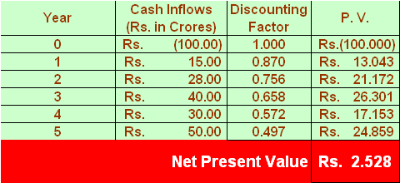
EXAMPLE – Answer ESTIMATING NPV

Slide 62
Internal rate of return (IRR)
IRR is that rate of return where the present value of cash inflows = present value of cash outflows; or is that discount rate at which NPV becomes zero
Meaning
A project is generally accepted if its IRR > Required rate of return
Kindly Note
IRR assumes that all cash flows are reinvested at the SAME RATE which is equal to IRR.

Slide 63
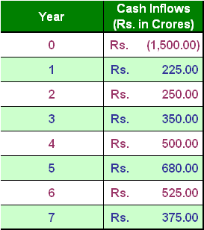
EXAMPLE – Question ESTIMATING IRR
Consider the following project with associated cash flows:

Slide 64
EXAMPLE – Answer ESTIMATING IRR
Year | Cash Inflows (Rs. in Crores)
0 | Rs. (1,500.00)
1 | Rs. 225.00
2 | Rs. 250.00
3 | Rs. 350.00
4 | Rs. 500.00
5 | Rs. 680.00
6 | Rs. 525.00
7 | Rs. 375.00
IRR | 17.00%

Slide 65
NPV Vs. IRR
NPV:
NPV is unique.
NPV can be calculated by taking different discount rates for different time periods.
NPV can be used to compare projects with different sizes.
NPV is additive.
IRR:
IRR is easy to understand.
If more than one cash outflows are occurring between future cash inflows, there can be multiple IRR, the interpretation of which is difficult.
IRR is based on the assumption that all future cash inflows are reinvested at IRR does not seem a realistic assumption.
IRR is not additive.
NPV is a better choice over IRR.

Slide 66
Now, let’s move to a case…
…Where we are taking capital budgeting decisions under FUND CONSTRAINT!!!

Slide 67
Suggest which projects should be selected if there is a budget of Rs. 100 crores.
RANK THE FOLLOWING PROJECTS ASSUMING THAT WE HAVE A CAPITAL BUDGET OF Rs. 100 CRORES
PROJECTS | COST OF PROJECTS | NPV | IRR
P1 | Rs. 20.00 | Rs. 9.00 | 15.25%
P2 | Rs. 40.00 | Rs.15.00 | 14.75%
P3 | Rs. 30.00 | Rs.10.00 | 16.00%
P4 | Rs. 70.00 | Rs.20.00 | 18.00%
P5 | Rs. 80.00 | Rs.25.00 | 17.50%
P6 | Rs. 10.00 | Rs. 6.00 | 15.00%

Slide 68
Use PROFITABILITY INDEX.
PI = (NPV/Cost of the Project)
RANK THE FOLLOWING PROJECTS ASSUMING THAT WE HAVE A CAPITAL BUDGET OF Rs. 100 CRORES
PROJECTS | COST OF PROJECTS | NPV | Profitability Index
P6 | Rs. 10.00 | Rs. 6.00 | 60.00%
P1 | Rs. 20.00 | Rs. 9.00 | 45.00%
P2 | Rs. 40.00 | Rs.15.00 | 37.50%
P3 | Rs. 30.00 | Rs.10.00 | 33.33%
P5 | Rs. 80.00 | Rs.25.00 | 31.25%
P4 | Rs. 70.00 | Rs.20.00 | 28.57%

Slide 69
What next…?

Slide 70
Our next CHALLENGE of capital budgeting decision – Measuring and Managing RISK!
Risk Vs. Uncertainty

Slide 71
Please recall the following about risk...
the PROBABILITY OF LOSS
the EXPECTED LOSS
VARIATIONS & FLUCTUATIONS:
Range
Mean Absolute Deviation
Standard Deviation/Variance/Coefficient of Variation
Semi-Variance
Variance from Subjective Expected Value
Co-variance
the SENSITIVITY OF RETURN TO POSSIBLE CHANGES - percentage changes.

Slide 72
HOW TO GO ABOUT RISK ANALYSIS?
Whatever way one goes for Risk Analysis, that must be a systematic and in a planned way.
There are many ways that are broadly classified as thus:
CRUDE METHODS
QUANTITATIVE METHODS

Slide 73
CRUDE WAYS OF RISK ANALYSIS
Conservative estimates of the revenues
Worst estimates of the project duration
Worst estimates of cost of project
Safety margins/ contingencies in the costs
Subjective judgements

Slide 74
QUANTITATIVE TOOLS FOR RISK ESTIMATION AND ANALYSIS
PAY BACK PERIOD
RISK ADJUSTED METHODS :
RISK ADJUSTED DISCOUNT RATE METHOD
CERTAINTY EQUIVALENT METHOD
SENSITIVITY ANALYSIS
SCENARIO ANALYSIS
SIMULATION METHODS

Slide 75
PAY BACK PERIOD…
… no of years within which one recover the amount invested in a project.
Higher the payback period, higher is the degree of risk.

Slide 76
RISK ADJUSTED METHODS
There are two ways through which the risk can be incorporated in our process of capital budgeting decisions.
They are –
RISK ADJUSTED DISCOUNT RATE METHOD; and
CERTAINTY EQUIVALENT METHOD

Slide 77
SENSITIVITY ANALYSIS
It is a quantitative process to perform “what if” analysis. It starts with some change in some variable's)/parameter(s) and studies the consequent impact on the variable(s) of the interest. The usual practice is to change the sales volume/capacity utilization and then study its impact on NPV or IRR.
Such an analysis can be performed either by changing the variables by some percentage or by an absolute amount.
Objectives:
To test reliability, robustness, consistency and sensitivity of the estimates of a project; and
To determine the likelihood impact of the undesirable and uncertain events on the viability of a project.

Slide 78
Other Methods…
Scenario Analysis:
It is a way of predicting probable values of parameters of interest based on certain future potential events.
It is used to predict what might happen to a project if specific events occur or don’t occur.
It is similar to Sensitivity Analysis except in it we can change a number of assumptions simultaneously and then, study the effect of the same on, say, NPV and IRR.
Simulation Methods:
In it, a model is made representing ‘the true project’ and then, experimentations are done on the same and try to gauge what will be the behaviour of the real project and probable outcomes of the same.
After experimentation, based on the results obtained necessary inferences are made about the proposed project.

Slide 79
Having discussed about risk, the next challenge is how to MANAGE RISK?
AVOID THE RISK
RISK - KITE
TRANSFER THE RISK
REDUCE THE RISK
ACCEPT THE RISK

Slide 80
Learning mitigating the risk…
Delays in various clearances such as Environment
Unsuitable Technology from the supplier of technology
Force majeure including the act of GOD
Non availability of debt at the reasonable prices
Undesirable movements in the foreign exchange rates
Changes in laws regarding polluting industries in a particular area.
Increase in the cost of basic raw material
Delays in completion of projects on time
Ways to mitigate risk:
Avoid the risk;
Reduce the risk;
Transfer the risk; and
Accept the risk.

Slide 81

By now, you must be feeling good about Finance!!!

Slide 82
While we were discussing capital budgeting decisions, are you not wondering how the companies are determining their discount rate?
That is going to be our next item in the agenda …

Slide 83
Cost of Capital…

Slide 84

Now, let’s start with our Agenda…
As the cost of capital is taken as Discount Rate for capital budgeting decision.

Slide 85
Please note that …
Every rupee spent by a company has a COST!!!!
Cost of Capital determines → Discount Rate → NPV; therefore, to increase the VALUE FOR SHAREHOLDERS, REDUCE THE COST OF CAPITAL:
↓ Cost of Capital → ↓r → ↑NPV →↑Value for shareholders

Slide 86
Cost of Capital …
It is the minimum rate of return that a firm must earn on its investments so as to leave market price of its shares unchanged.
It is also referred to as cut-off rate, target rate, hurdle rate, required rate of return and so on.

Slide 87
Cost of Capital …Continued
It is defined as the weighted average cost of capital (k₀) of all long-term sources of finance. The major long-term sources of funds are -
Debt,
Preference shares,
Equity capital, and
Retained earnings.

Slide 88
Cost of Capital …Continued
Please note that cost of capital is –
OPPORTUNITY COST!!!!!!
It is Expected rate of return that investors could earn elsewhere on investments with similar characteristics.

Slide 89
COST OF CAPITAL
RISK
USE OF CAPITAL
FUNDS/CAPITAL
DEBT
PREFERENCE SHARES
EQUITY CAPITAL
RETAINED EARNINGS
BASIC
STRUCTURE

Slide 90
Cost of Capital means…
WEIGHTED AVERAGE COST OF CAPITAL (WACC)

Slide 91
WEIGHTED AVERAGE COST OF CAPITAL (WACC)
If a firm uses all possible sources of financing, the cost of capital must include the cost of each, weighted to proportion of each in the firm’s capital structure.

Slide 92
Weighted Average Cost of Capital
Assuming that a firm is using only Debt and Equity, the weighted average cost of capital (WACC) is capital structure-weighted average of the after-tax cost of debt and equity
Notes:
92
One of the key take aways from the capital structure material is that, for valuation purposes, what matters is market value, not book value. This is especially true for WACC’s. Book value weights are meaningless in WACC calculations. From your capital providers’ perspective, they want you to earn a rate of return on the current value of their investment, not some historical measure of their investment.
All the terms on the right hand side (RHS) of the formula are a function of the capital structure: if you increase leverage, the debt of the firm potentially gets risker, and r(d) would increase. If you increase interest expense so much that you run out of taxable income, then the marginal tax rate potentially decreases at some point. But most importantly is that, as leverage increases, the cost of equity (reL) increases. This is the reason we include the L subscript, to denote that this is the levered cost of equity (for the level of leverage included in the formula).
What leverage (D/(D+E)) is used in the formula? Historical? Current? It depends on what you are doing with the WACC. If you are comparing it to last years ROIC to calculate Economic Profit (see KGW, chapter 3) for last year, then you want last year’s historical leverage.
But for our purposes, we want to value projects, strategies and firms. The cash flows on these investments are in the future, so we want “target” or expected future capital structure. Of course, history and current may inform our expectations of the future.

Slide 93
COST OF DEBT/BORROWED FUNDS
Cost of debt is always calculated in terms of–
PREVAILING INTEREST RATE
Cost of borrowed funds is –
THE INTEREST RATE TO BE PAID
After tax cost will be: Interest Rate (1-t) where ‘t‘ is the tax rate.

Slide 94
COST OF PREFERENCE SHARES
Cost of preference shares is always calculated in terms of–
The Dividend paid on them

Slide 95
COST OF EQUITY
Cost of equity is determined by using VALUATION APPROACH to equity because there is a negative relation between the VALUE and COST of Equity – higher the cost of equity, lower the value of equity!
If we know the value of equity and the relevant parameters of valuation, then one can easily determine the cost of equity.

Slide 96
HOW TO DETERMINE THE VALUE OF SHARE ………??????
One of the tool to determine the cost of equity is -
Capital Asset Pricing Model (CAPM)
Notes:
96

Slide 97
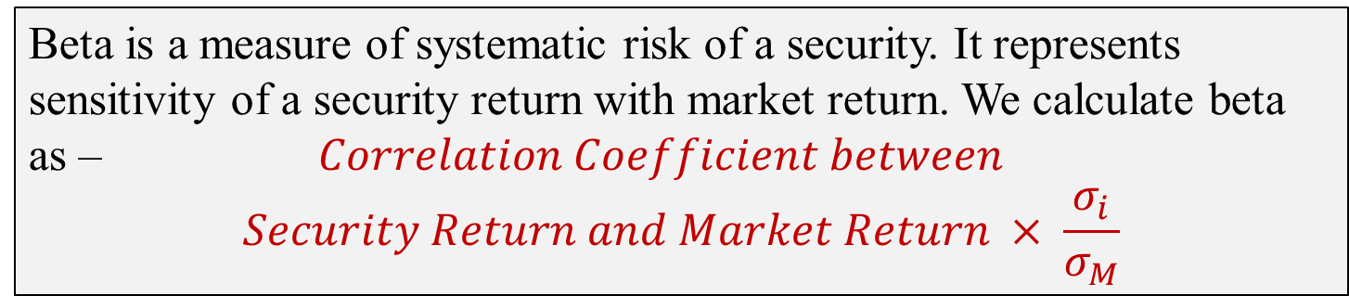
Capital Asset Pricing Model
Using CAPM, one can determine cost of an equity.
Beta is a measure of systematic risk of a security. It represents sensitivity of a security return with market return. We calculate beta as – $Correlation Coefficient between$
$$Security Return and Market Return × \frac{σ_{i}}{σ_{M}}$$

Slide 98
COST OF EQUITY USING CAPM…EXAMPLE
Assume that in a market, CAPM works. If the risk free rate is 7.60%, the return on the market benchmark is 14.50% and the beta is 1.25, then you are required to determine the cost of equity.

Slide 99
Cost of Retained Earnings…
Cost of retained earnings is calculated by taking the cost of equity; that is to say, the cost of retained earnings is equal to the cost of equity.

Slide 100
Friends, in this session, we try to learn…
Basics of Finance – which is viewed as managing the financial sources or funds of a company so as to MAXIMIZE SHAREHOLDERS’ VALUE.
We also discussed about basic principles of Finance.
We tried to learn about time value of money.
Then, we discussed about capital budgeting decisions – Pay Back Period, NPV, IRR and also, learnt about risk and management of risk of a project.
After all these, we moved to discuss cost of capital which is defined as weighted average cost of capital (WACC) of debt, preference shares, equity and retained earnings.
Finally, we talked about CAPM and beta.

Slide 101

THANK YOU

